Slide 1
Mack/Murphy Unchained
CLRS 2018 Anaheim CA Daniel Murphy Trinostics

Slide 2
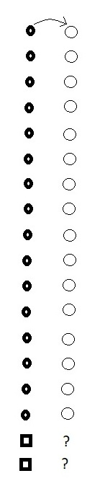

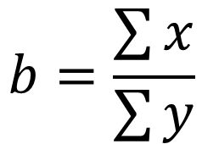
Chain-Ladder: First link The method
method
$$y=bx$$
We observe some objects that have changed over time
We observe two new objects
What is an estimate of their changed values?
traditional average link ratio
$$b=\frac{\sum{x}}{\sum{y}}$$

Slide 3

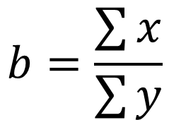




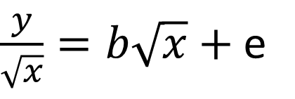

Chain-Ladder: First link The Model
model
$$y=bx+ \sqrt{x}e$$
solves model
$$b=\frac{\sum{x}}{\sum{y}}$$
The traditional weighted average link ratio solves this model via MSE
Because it also solves the equivalent model
$$b={(X`X)}^{−1}X`Y$$
$\frac{y}{\sqrt{x}}=b\sqrt{x}+$e
equivalent model
$$or$$
$$minimizes$$
$$\sum{{\left(Y−bX\right)}^{2}}$$
$$Y=bX+e$$

Slide 4

Chain-Ladder: First link
Chain-Ladder: First link
Chain-Ladder: First link
Graph for this triangle
$$y=bx+ \sqrt{x}e$$

Slide 5
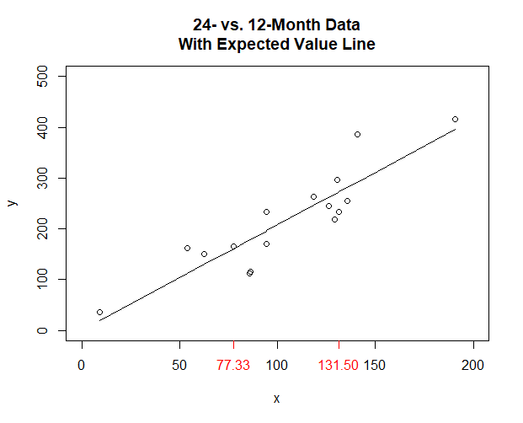

Development experience
slope of the line = 2.037 =
new points awaiting blastoff
$$\frac{\sum{x}}{\sum{y}}$$

Slide 6
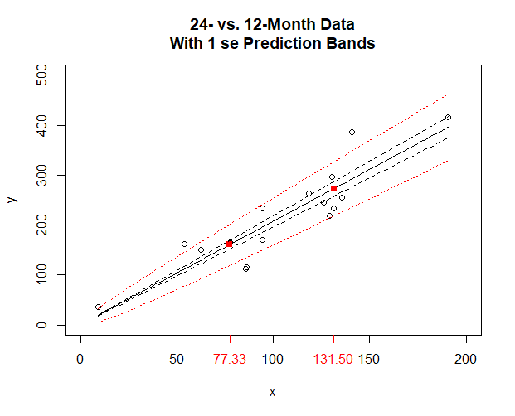
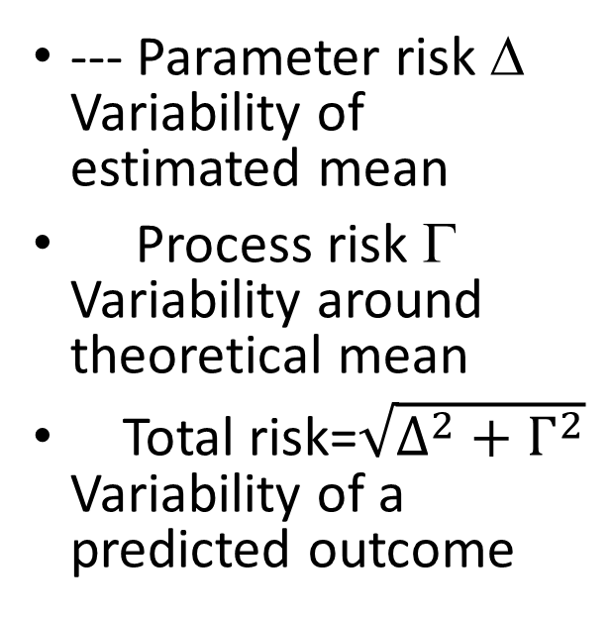
Predicted experience with “confidence levels”
--- Parameter risk Δ Variability of estimated mean
Process risk Γ Variability around theoretical mean
Total risk=$\sqrt{Δ^{2}+Γ^{2}}$ Variability of a predicted outcome

Slide 7

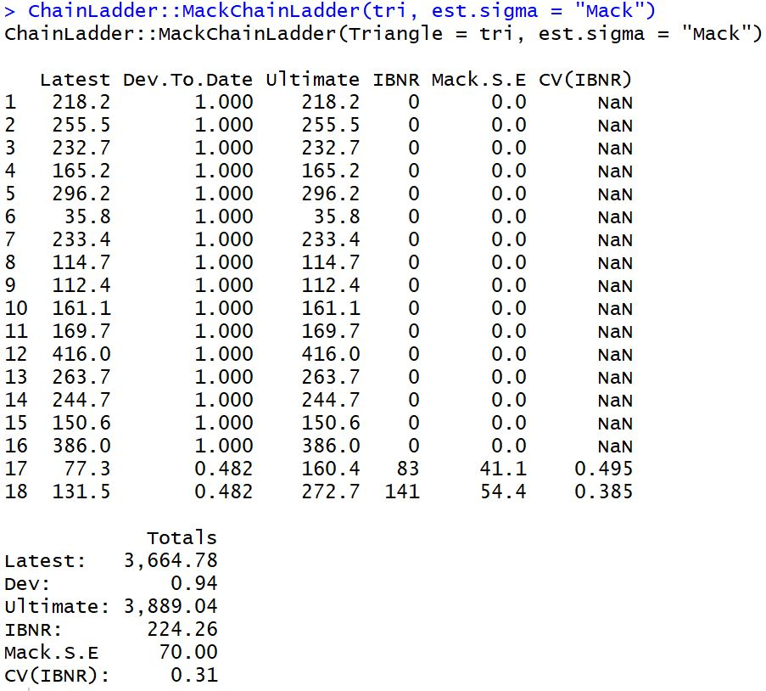

Predicted experience with “confidence levels”
With
} 54.4
} 41.1

Slide 8
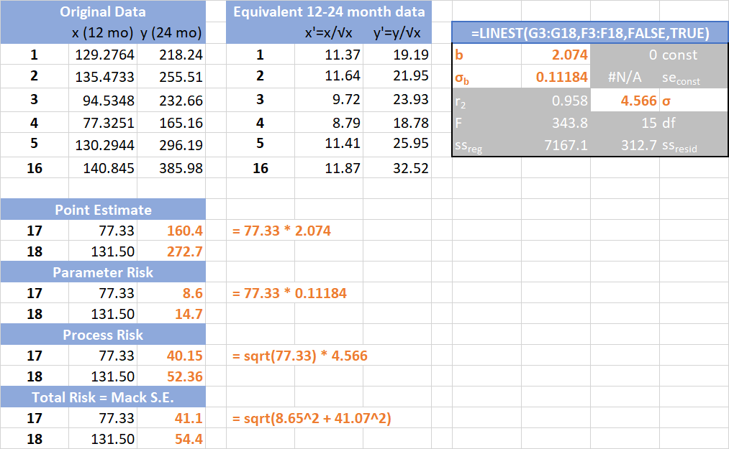
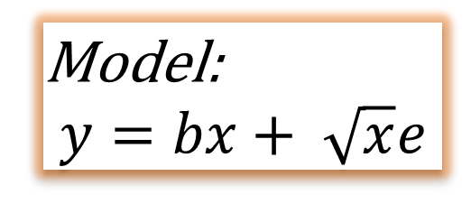
In Excel
Model:
$$y=bx+ \sqrt{x}e$$

Slide 9
Why does the prediction envelope fan out only at the high end?

Slide 10

Chain-Ladder error term
model
$$y=bx+ \sqrt{x}e$$
Assumption: The higher the initial value, the greater the variability of the subsequent value
For what types of situations might this assumption not hold?
When might you have less variability the larger the beginning value and more variability the smaller the beginning value?
Notes:
Strong assumption

Slide 11
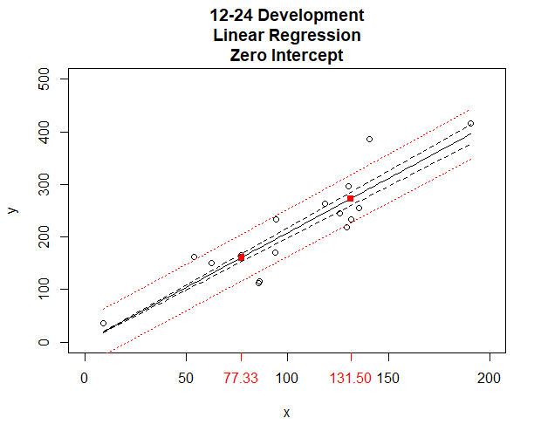
Prediction bands without heteroskedasticity
--- parameter risk
total risk
Notes:
image Dev12-24LinRegZeroIntercept.png
script WithIntercept MoreDisperse.R

Slide 12
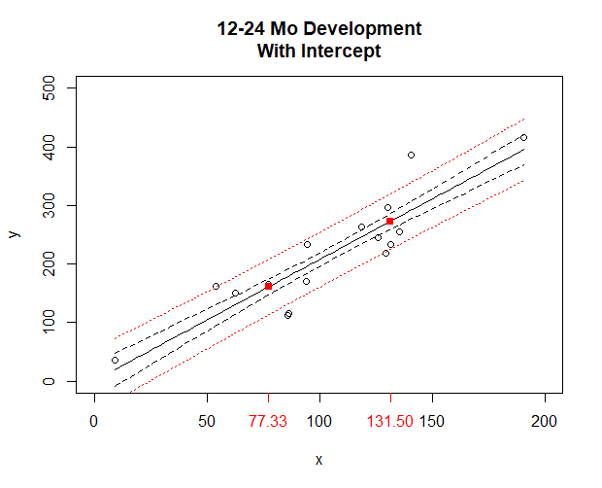
Prediction bands providing for an intercept
--- parameter risk
total risk

Slide 13
Add another column: Second link

Slide 14
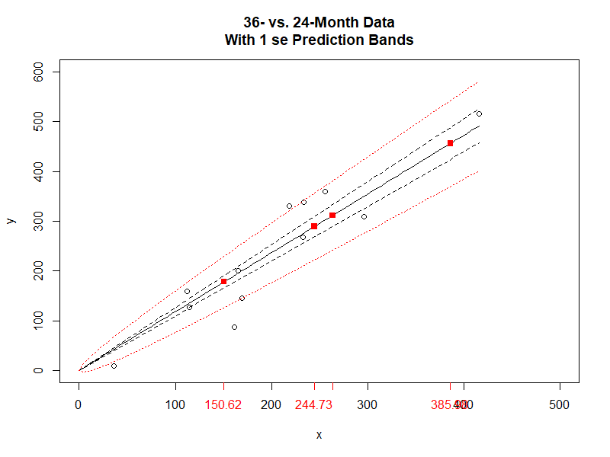
Add another column: Second link
b hat = 1.181
sigma_b = 0.083
sigma = 4.1

Slide 15
Recursive projection statistics
Orange projections are products of a scalar and an estimated parameter
See above for risk formulas
Red projections are products of an estimate and an estimated parameter
Formulas for Parameter Risk and Process Risk are derived from the Law of Total Variance
Which is which?

Slide 16
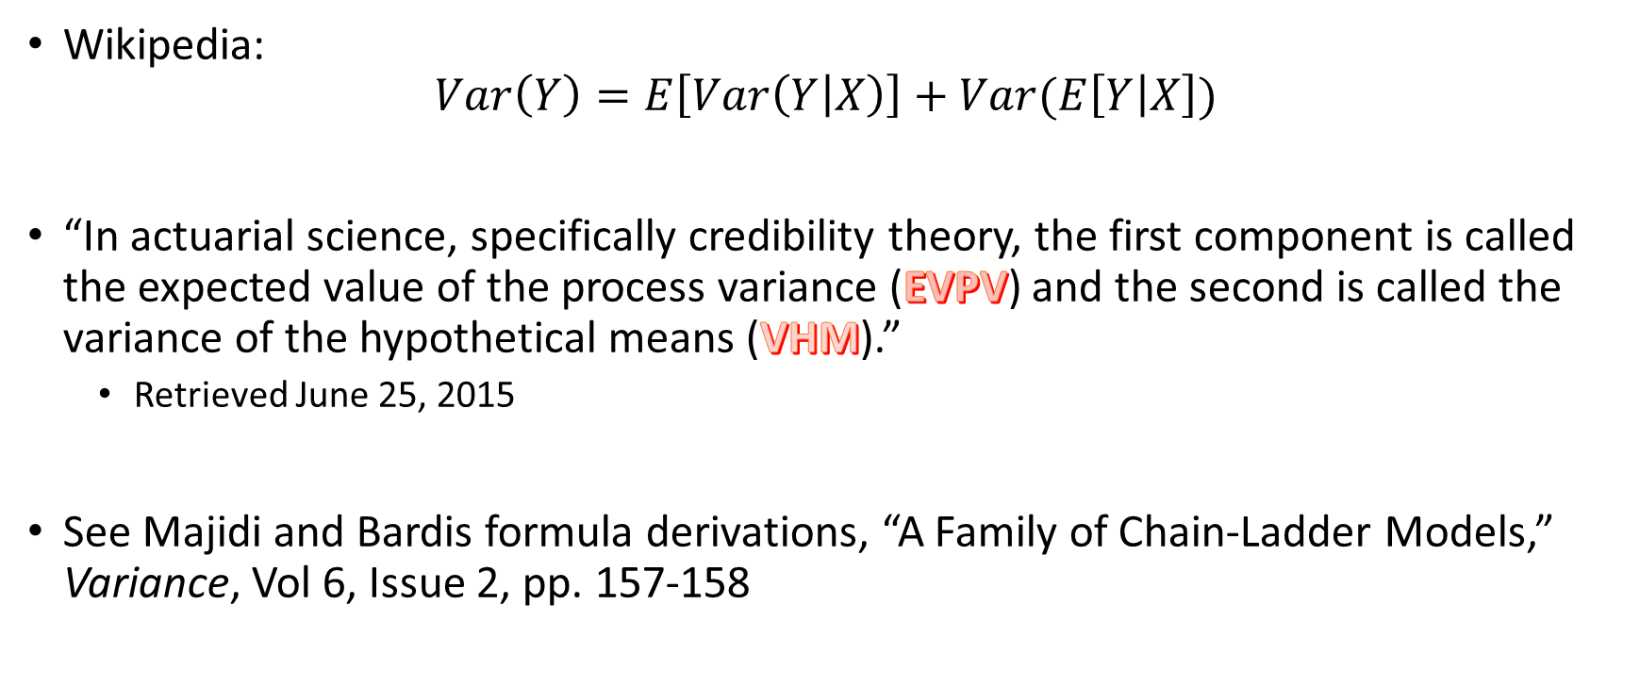
Law of Total Variance
Wikipedia: $Var\left(Y\right)=E\left[Var\left(Y | X\right)\right]+Var(E\left[Y | X\right])$
“In actuarial science, specifically credibility theory, the first component is called the expected value of the process variance (EVPV) and the second is called the variance of the hypothetical means (VHM).”
Retrieved June 25, 2015
See Majidi and Bardis formula derivations, “A Family of Chain-Ladder Models,” Variance, Vol 6, Issue 2, pp. 157-158

Slide 17

Recursive Formulae by hand
Expected Value – complete the square
Parameter Risk – Δ
$$Δ_{y}^{2}=x^{2}⋅{\hat{σ_{b}}}^{2}$$
$$Δ_{z}^{2}={\hat{y}}^{2}⋅{\hat{σ_{b}}}^{2}+{\hat{b}}^{2}⋅Δ_{y}^{2}+{\hat{σ_{b}}}^{2}⋅Δ_{y}^{2}$$
Process Risk – Γ
$$Γ_{y}^{2}=x⋅{\hat{σ_{x}}}^{2}$$
$$Γ_{z}^{2}=\hat{y}⋅{\hat{σ_{y}}}^{2}+{\hat{b}}^{2}{⋅Γ}_{y}^{2}$$
Don’t forget to transform the data before running LINEST
Notes:
Save all the statistics and intermediate steps

Slide 18
The Tricks for the Risk Estimates for the Total Row

Slide 19
Complete the Chain to Ultimate
The recursive estimates are carried forward to the last pair of development columns
Technical considerations
What to do when there are not enough observations to get a good estimate of sigma (zero degrees of freedom)
What to do with a tail
Mack has recommendations for handling these technicalities
The ChainLadder package’s MackChainLadder function includes Mack’s recommendations, as well as others
Let’s see some examples

Slide 20
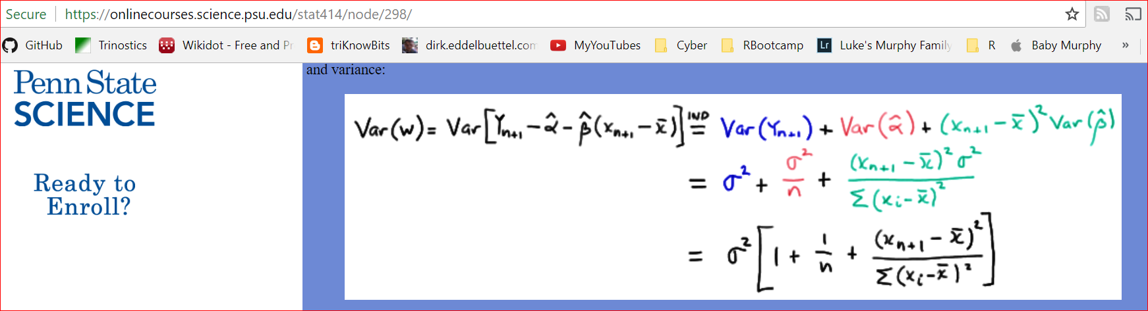

Slide 21
ChainLadder sample GL triangle ‘GenIns’
(in thousands)

Slide 22
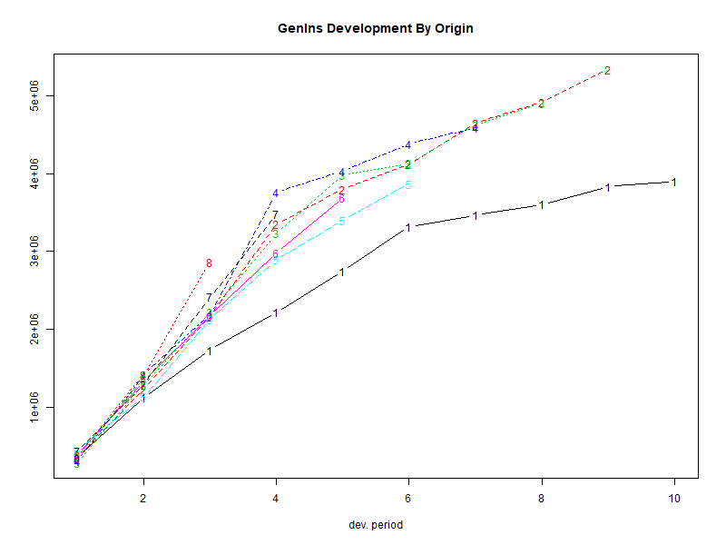
plot(GenIns)

Slide 23
ChainLadder::MackChainLadder(GenIns)

Slide 24
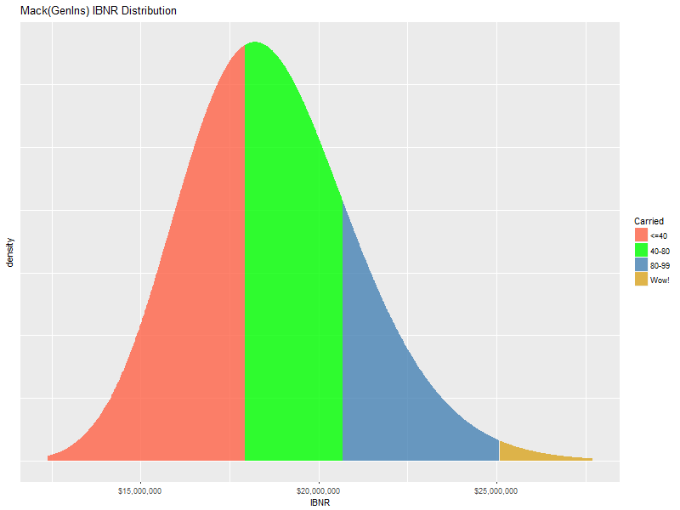
Safety Levels of GenIns Carried IBNR

Slide 25
GenIns at the Claim Level
Hai You generated simulations of over 5000 synthetic claims whose accident year aggregation is “close to” GenIns
We pegged the 13% cv as the measurement of similarity
Claim-characteristic choices included:
Frequency distribution
Severity distribution
Distribution for the number of payments per claim
Report lag and payment lag
The purpose of this exercise was to compare the Mack results on the aggregated triangle versus the claim detail

Slide 26
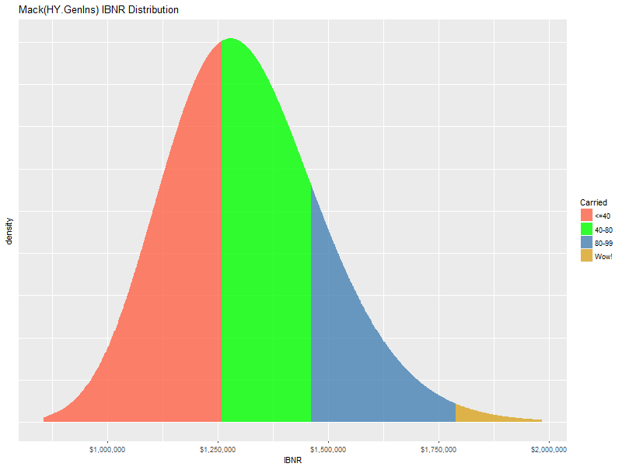
IBNR distributions have same shape
Original GenIns
Aggregated triangle from Hai data

Slide 27
GenIns at the Claim Level: Claim detail sample in triangle format
Why the IBNR drop? Why the CV drop?

Slide 28
Is the weighted average development factor appropriate?
Let’s plot the x-y relationship before we make up our minds

Slide 29
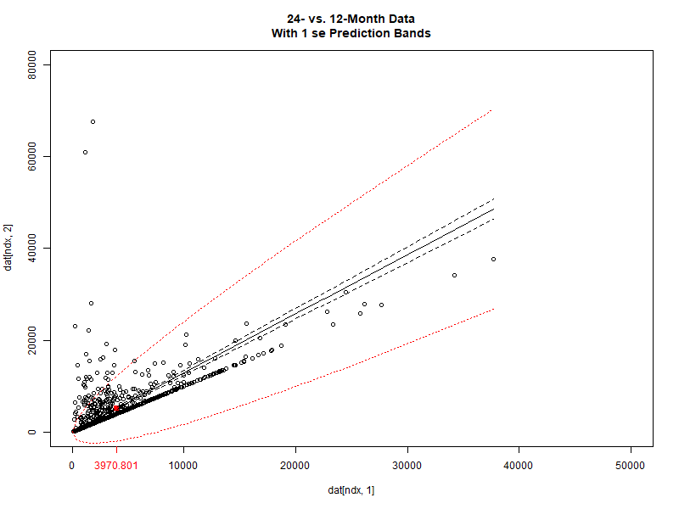
The 12-24 month relationship from the claim detail

Slide 30
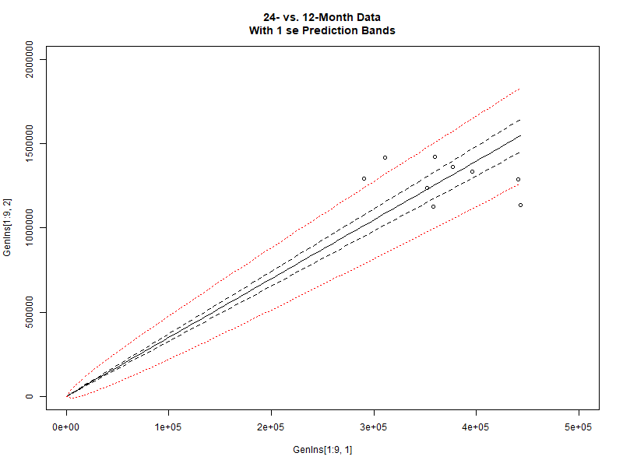
The 12-24 month relationship from the GenIns triangle

Slide 31
California WCIRB Agenda June 2018 Combined Indemnity and Medical Incurred

Slide 32
Mack(WCIRB Incurred Combined)

Slide 33
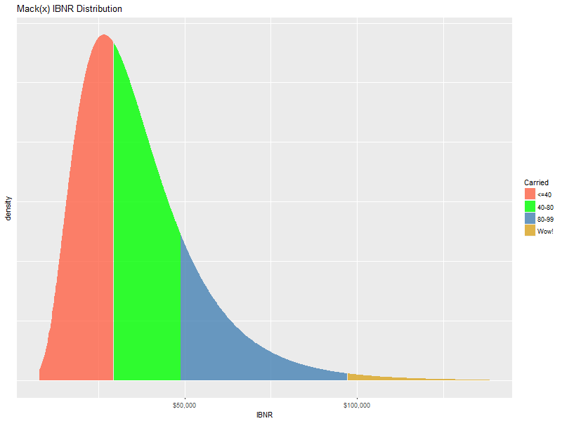
The industry shows IBNR = $36,196 =
~58%-ile

Slide 34
Q&A

Slide 35
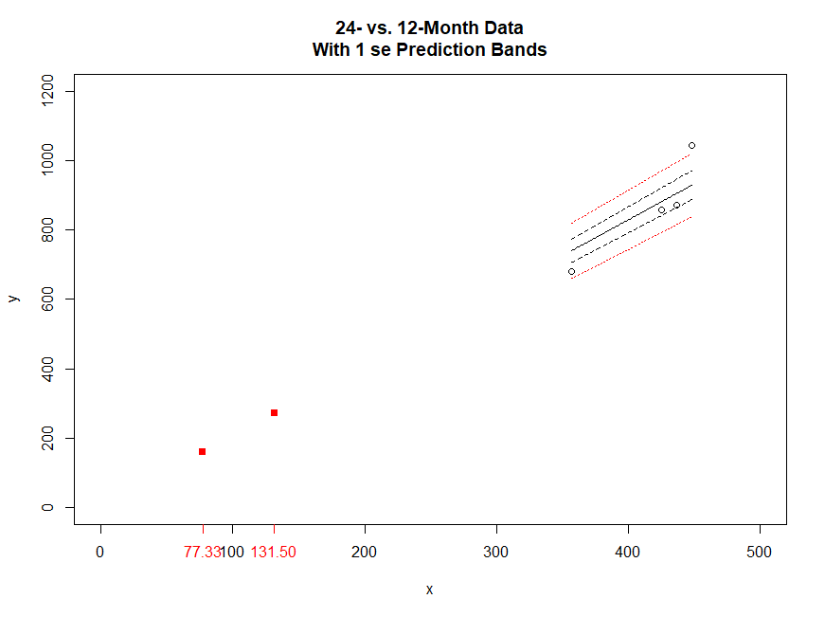
Now pretend data come from 4 companies and aggregate into 4 AYs

Slide 36
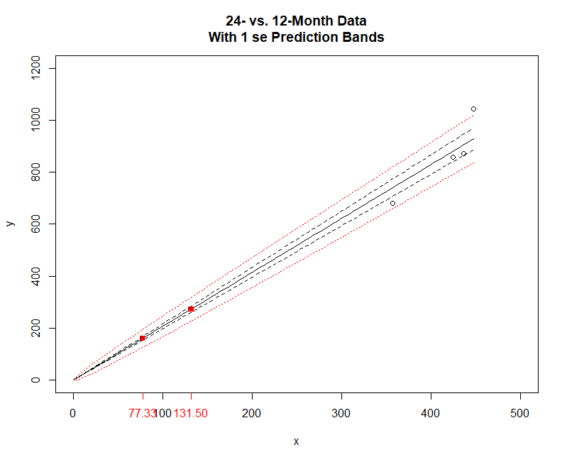
Now pretend data come from 4 companies and aggregate into 4 AYs

Slide 37
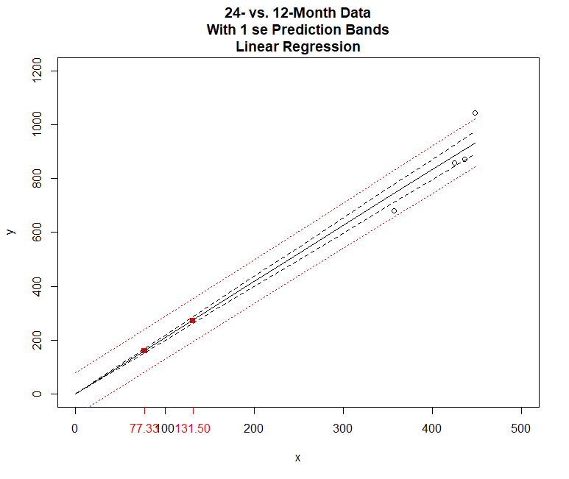
Linear regression standard error influence not diminished with small x

Slide 38
Predicted experience with “confidence levels”
In
} 54.4
} 41.1

Slide 39
Let’s regroup
} 54.4
} 41.1

Slide 40
Table
 | IBNR | Mack.S.E | Parameter | Process | b | sigma_b | sigma
Agg | 224.25 | 58.8 | 19.6 | 55.4 | 2.074 | 0.094 | 3.8
Det | 224.26 | 70.0 | 23.3 | 66.0 | 2.074 | 0.112 | 4.6

